Slide 1
Waiwera Aotearoa
Geothermal sampling at the frontier

Slide 2
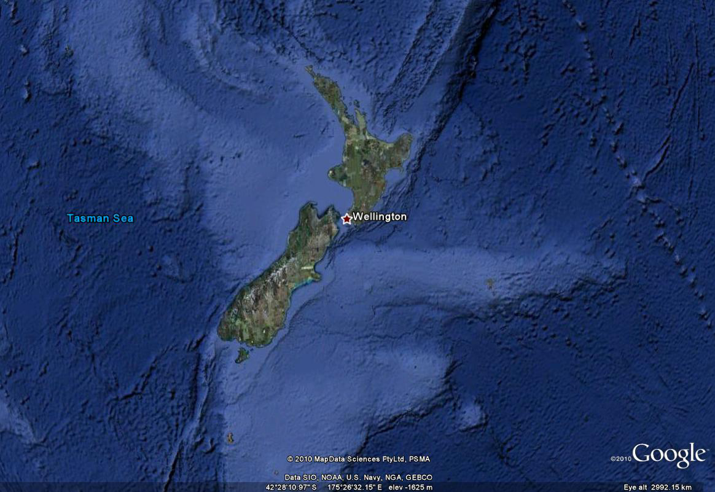
A Research Wonderland?
Marine Conservation
Coastal Processes
Volcanology
Geothermal
Soil Science
Restoration Ecology
Marine Research
Terrestrial Conservation
Plate Tectonics
Evolutionary Biology
Geomorphology
Limnology
Sub-Antarctic Research

Slide 3
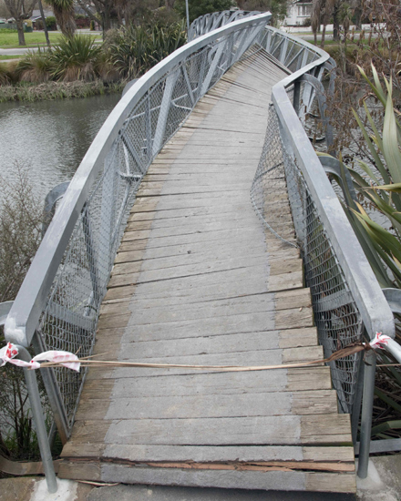
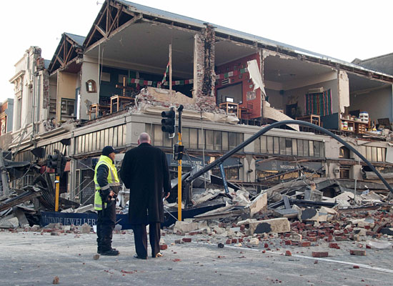
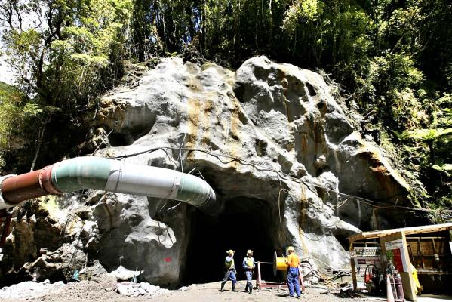
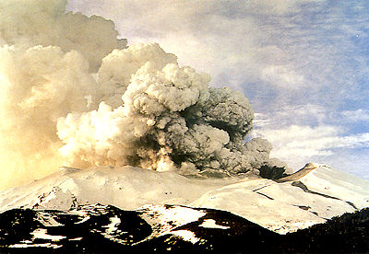
A Dynamic Environment

Slide 4
New Zealand’s North Island

Slide 5
The Taupo Volcanic Zone

Slide 6
Sampling Areas
Waimangu
Waikite
Wai-o-Tapu
Orakei-Korako

Slide 7
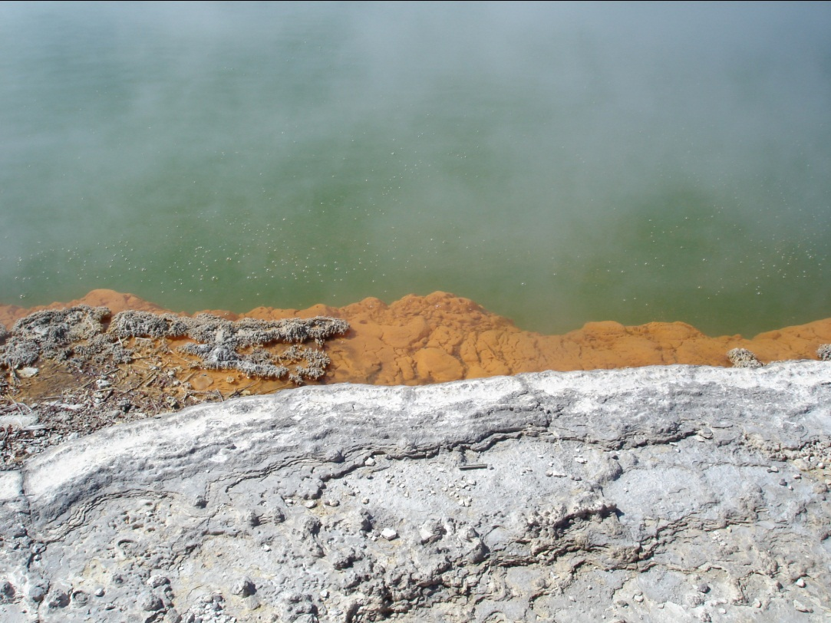
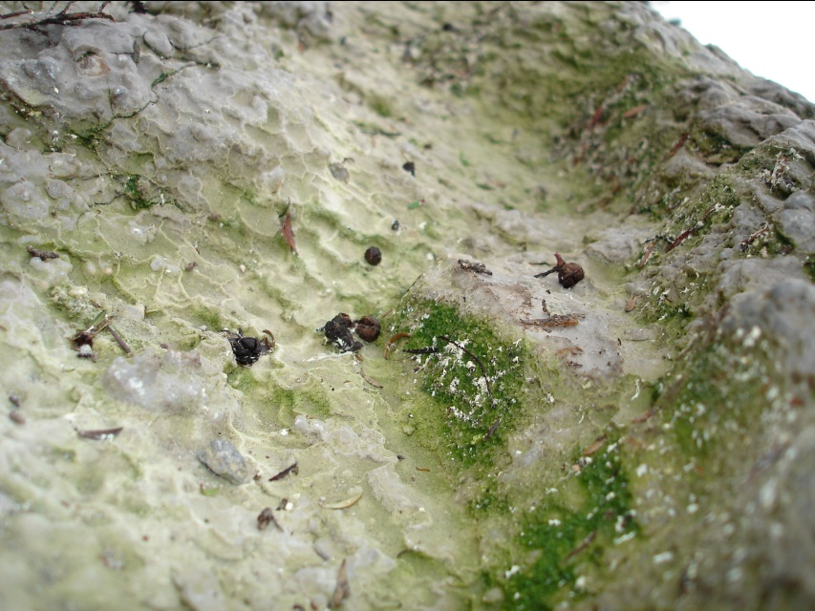
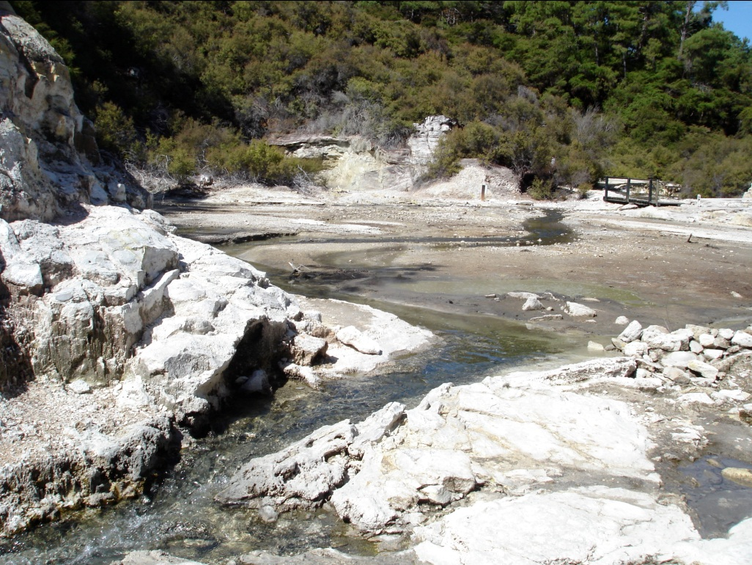
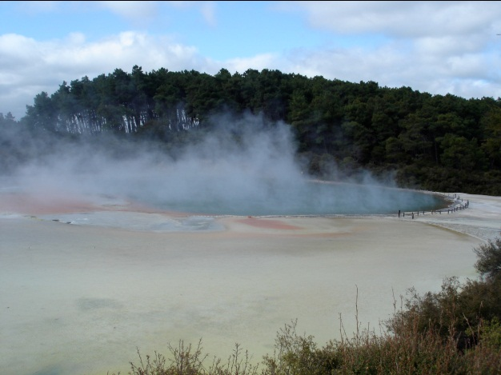
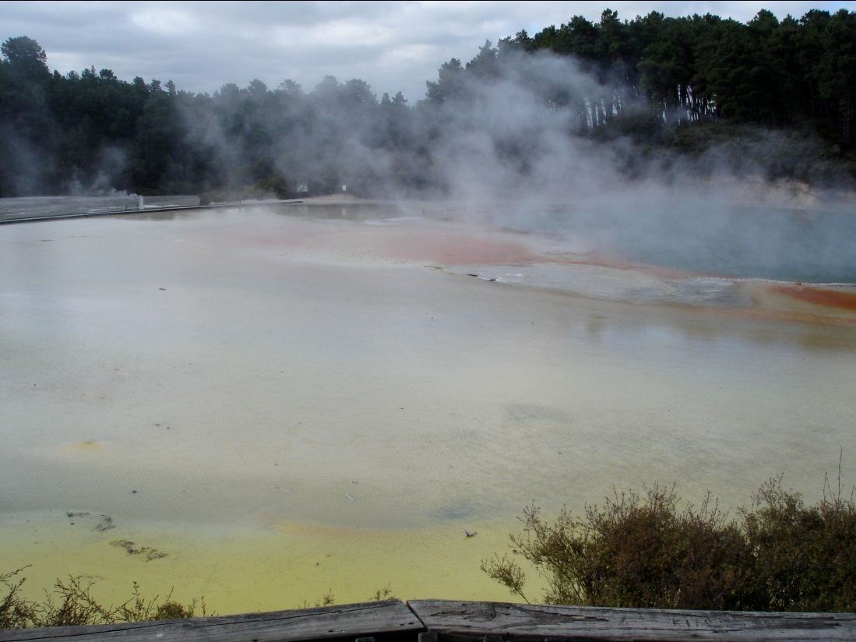
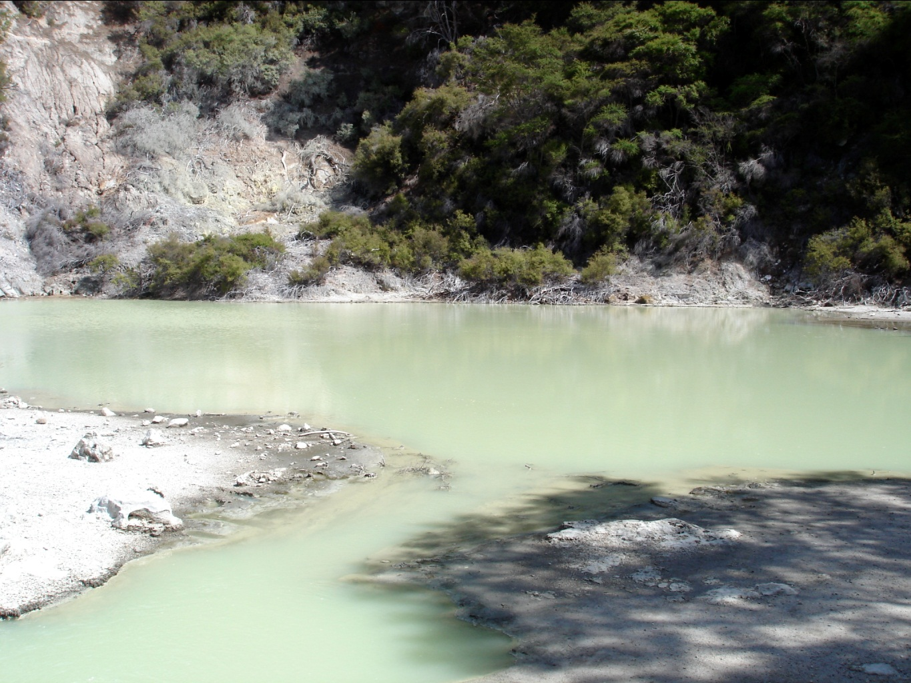
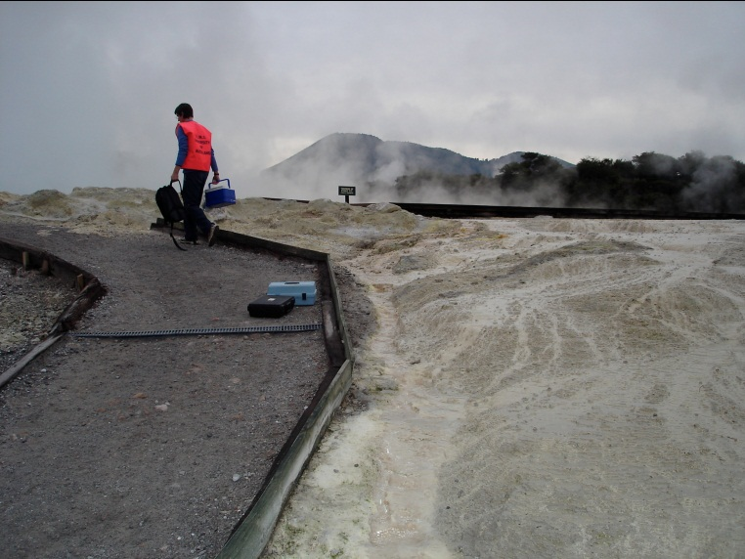
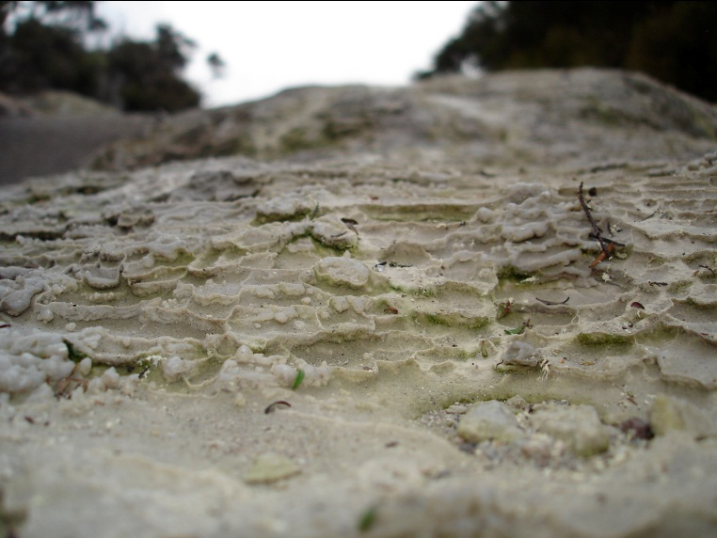
Wai-O-Tapu

Slide 8
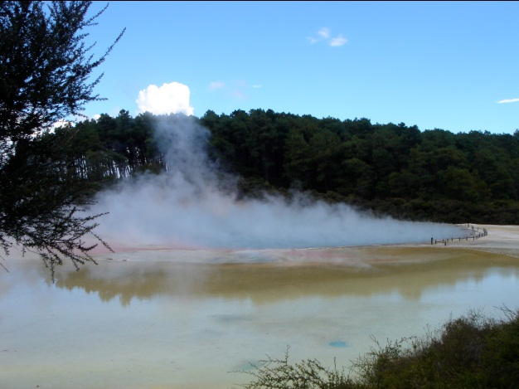
Champagne Pool
75 ºC
Alkali-chloride pool (Cl about 2000 mg/L; pH 5.5-6.5 at surface)
Very high As concentrations (>5 mg/L)
Probably high sulfide concentrations (not measured in a long time; sulfate 165 mg/L)
Low Sb at surface (at depth?)
Precipitate weight % Sb and As (with Au, Hg, Te high too)
Discharge has higher concentrations of metalloids than pool itself (during the day)

Slide 9
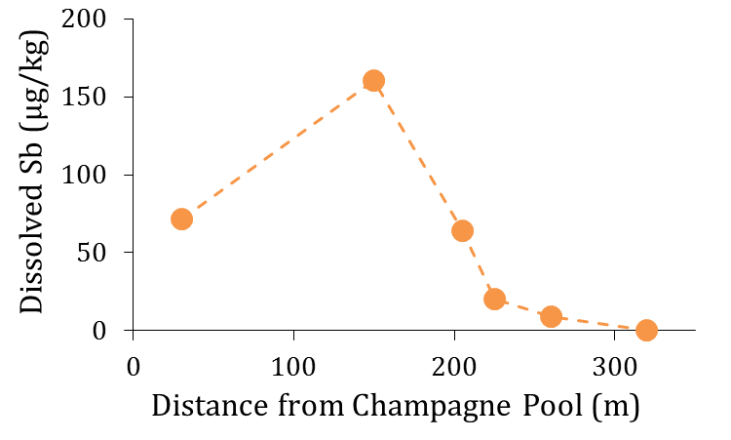
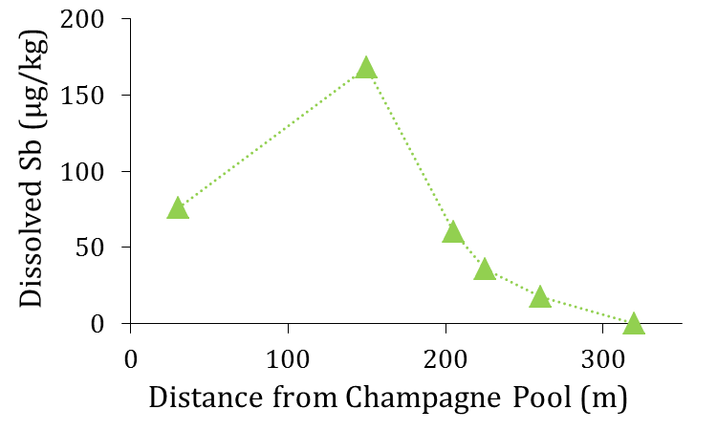
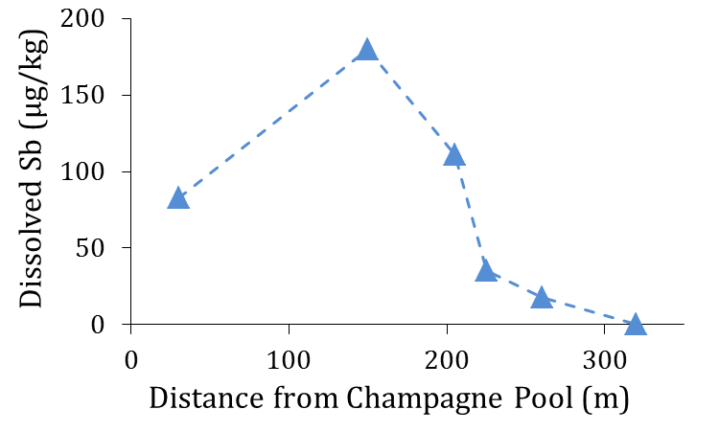
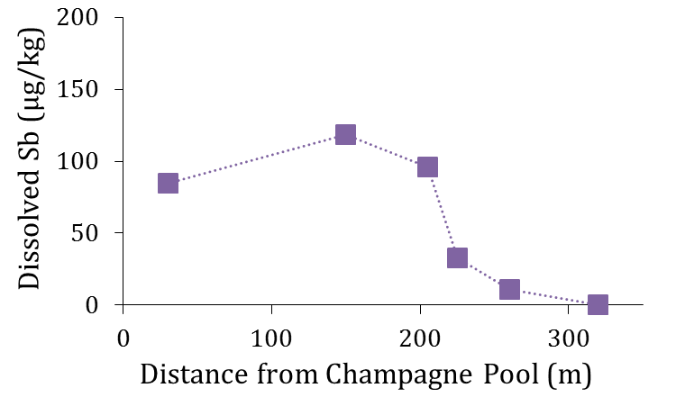
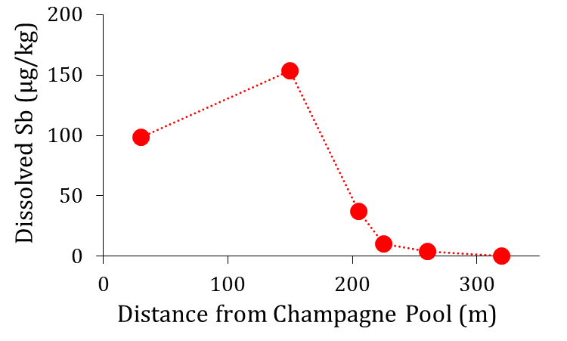
Sb by day
Time
09:00
11:30
13:00
14:30
16:00

Slide 10
Alum Lake
A sink for the As and Sb produced by Champagne Pool
1.5-4.0 mg/L sulfide
pH 2.5
Active As precipitation
2000 µg/L As upstream, 250 - 1000 µg/L As downstream
Similar phenomenon observed for Sb
Notes:
If can’t get at where they are going from thio-ate to thio-ite, then what about the reverse? The 35 oC pH 2.5 Alum lake has: 1.5-4.0 ppm H2S and 280-1000 ppb As (down from 2000 ppb upstream).

Slide 11
What I plan to do:
Collect some samples from Champagne Pool itself (any and all parameters possible, time series)
In addition, sample at the end of the sinter terrace.
Collect some samples from Alum Lake – thio-arsenites??

Slide 12
What could be done?
Known populations of bacteria and algae in the discharge. May also have things swimming about in Champagne Pool itself.
Depth study of Champagne Pool?

Slide 13
Waimangu
Waikite
Wai-o-Tapu
Orakei-Korako

Slide 14
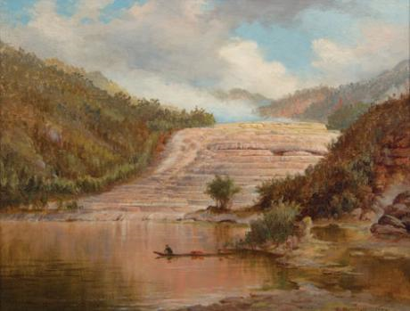
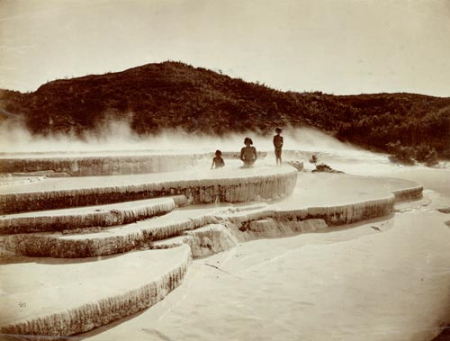
Ō-tū-kapua-rangi and Te Tarata
Notes:
Tattooed Rock (White) and Fountain of the Clouded Sky (Pink)

Slide 15
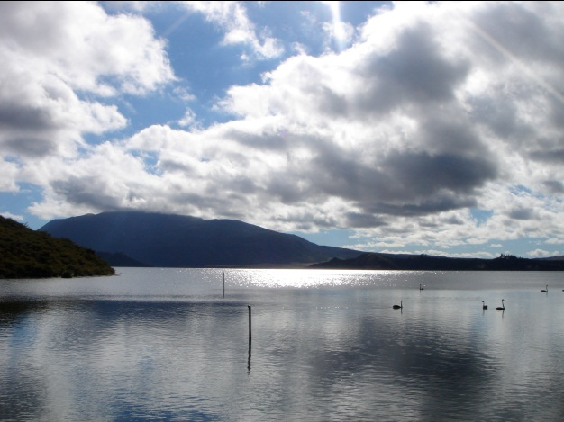
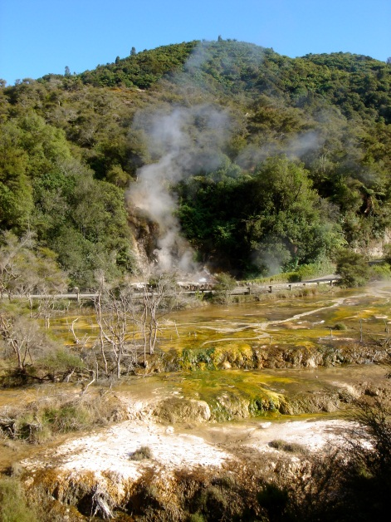
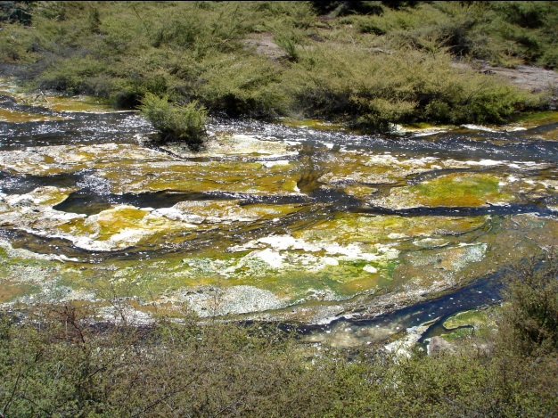
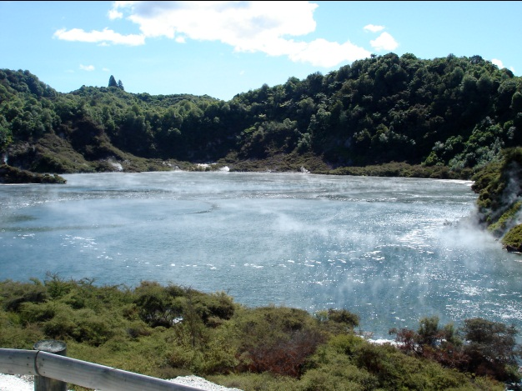
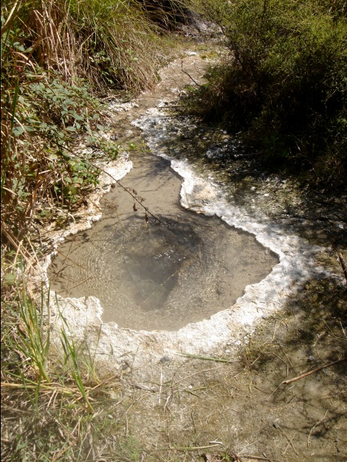
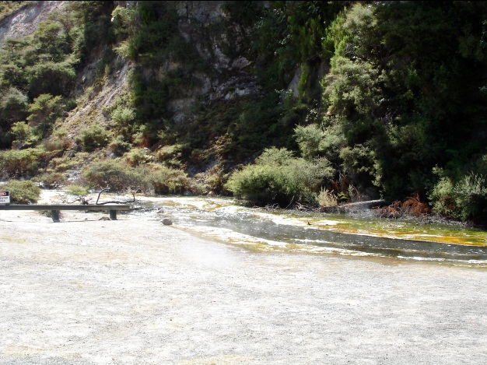
Waimangu

Slide 16
Lake Rotomahana
Research project to map the lake begins in January
Lake known to have geothermal inputs at bottom, and even at the surface, As concentrations are ~500 µg/L
Very likely the lake stratifies – do we get “weird” As species at the bottom?

Slide 17
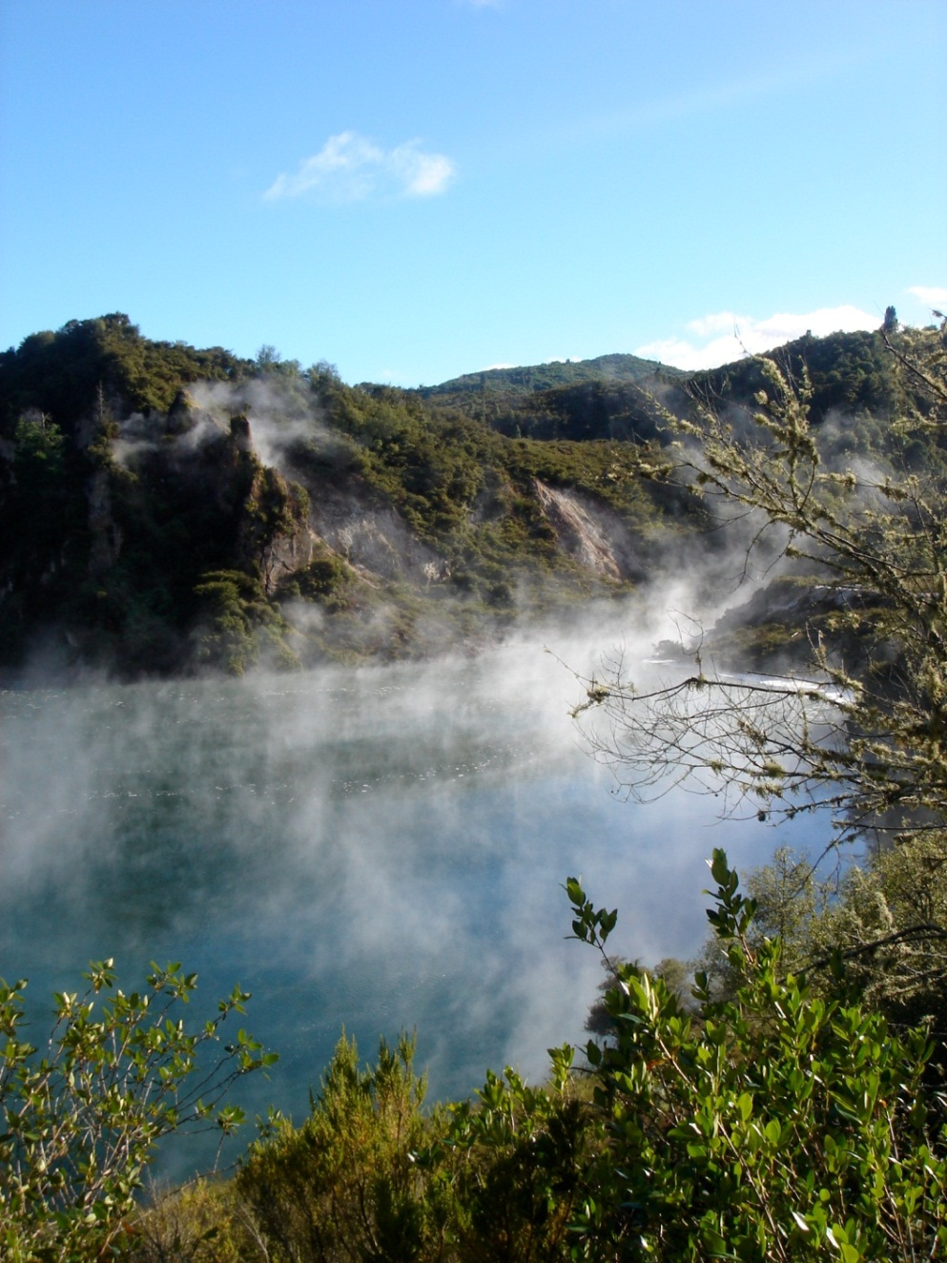
What I plan to do:
Some interesting pools, some with short drainage channels in this system. Little known about chemistry, so plan to sample them
Algae: plentiful and have high As contents – particles or accumulation?

Slide 18
Waimangu
Waikite
Wai-o-Tapu
Orakei-Korako

Slide 19
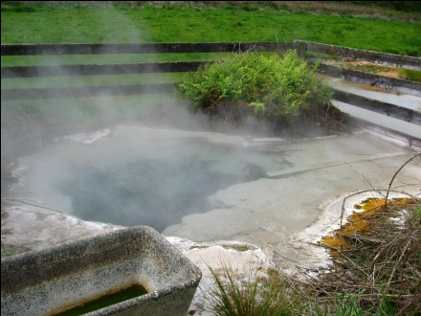
Waikite Valley

Slide 20
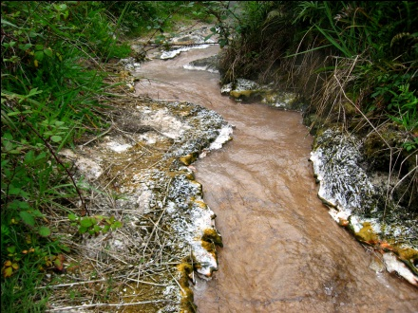
What’s in the pool at the top?
What happens along this discharge?
Is anything happening on the terrace?

Slide 21
What I plan to do:
Sample everywhere I can!
Particular focus on the two known pools, but may explore further along the valley too

Slide 22
Waimangu
Waikite
Wai-o-Tapu
Orakei-Korako

Slide 23
Orakei-Korako

Slide 24
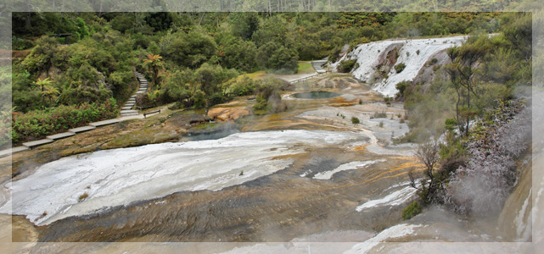
Sampling at Orakei-Korako
Very little known about Orakei-Korako features
Hope to apply for a permit next week, but not optimistic (waiting for response from Department of Conservation)

Slide 25
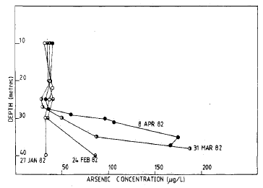
And just in case you want more…
The Waikato River:
From Aratiatia downstream, As concentrations as high as 30 µg/L
Macrophytes appear enriched in As (e.g. watercress, oxygen weed etc…)
When lakes stratify, As concentrations can increase substantially at the bottom

Slide 26
Final Thoughts
There is a lot that can be done!
At present, a lot of potential, but interest is growing (so we should get in soon)
Problems?
NZ is quite far away
Getting samples back intact may also be a challenge
Solution
Treat work in NZ like you would Bangladesh rather than Yellowstone – i.e. come for a while, not just a week or two

